Slide 1

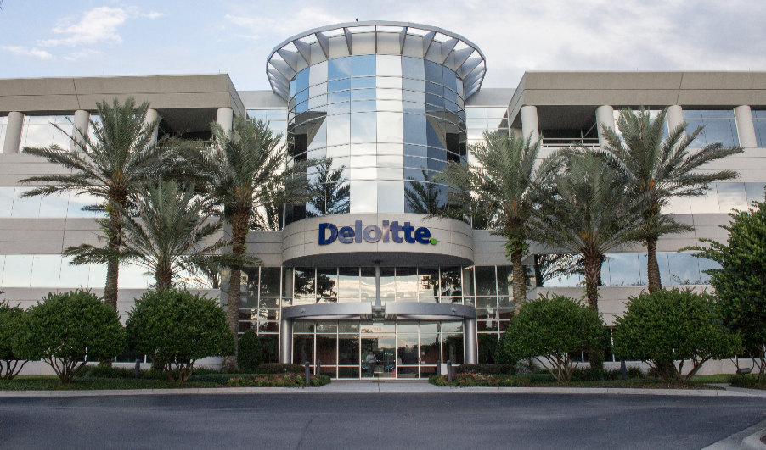
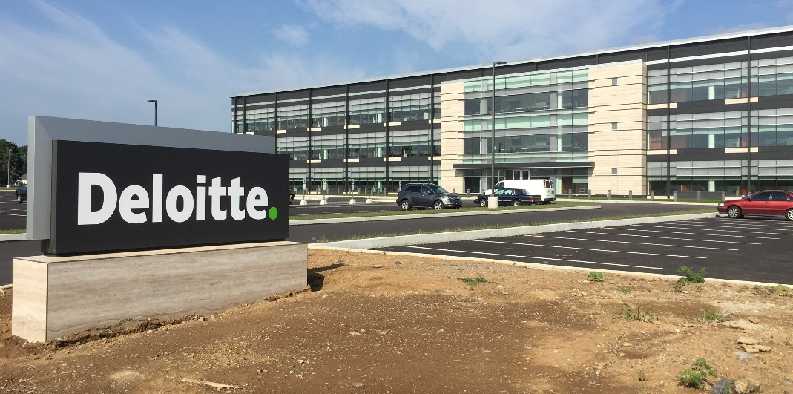
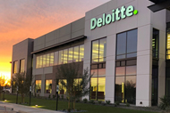
USDC Information Technology Center of Excellence (IT-CoE)
Topic: CompTIA Security+ Testing Review
Orlando, FL
Mechanicsburg, PA
Gilbert, AZ

Slide 2
Endpoint and Network Security
Session 9
Security+
CompTIA Security+
Test: SYO-601
EXAM OBJECTIVES (DOMAINS)
The table below lists the domains measured by this examination and the extent to which they are represented:
Session 9
Includes Objectives from Domains 2, 3 and 4
Objective 2.1 – Explain the importance of security concepts in an enterprise environment.
Objective 2.6 – Explain the security implications of embedded and specialized systems. Objective 3.2 – Given a scenario, implement host or application security solutions.
Objective 4.1 – Given a scenario, use the appropriate tool to assess organizational security.
Domain | Weight
1.0 Threats, Attacks and Vulnerabilities | 24%
2.0 Architecture and Design | 21%
3.0 Implementation | 25%
4.0 Operations and Incident Response | 16%
5.0 Governance, Risk, and Compliance | 14%
Total | 100%

Slide 3
Endpoint and Network Security
Session 9
Security+
Terminology
IDS – Intrusion Detection System – Monitors the network for possible intrusions and logs that activity.
IPS – Intrusion Prevention System – Monitors the network for possible intrusions, logs the activity, and then blocks the traffic that is suspected of being an attack.
DMZ – A network segment between two firewalls. One is outward facing, the other is inward facing, connected to the internal network. Public-facing servers, such as web servers are often placed in the DMZ.
Honeypot – A separate system that appears to have vulnerabilities and is an attractive target but is in reality a trap for hackers.
Firewalls – One of the first lines of defense in a network. The basic purpose is to isolate one network from another.
SDN – Software-defined networking. All components of a network, including all security devices, are virtualized.

Slide 4
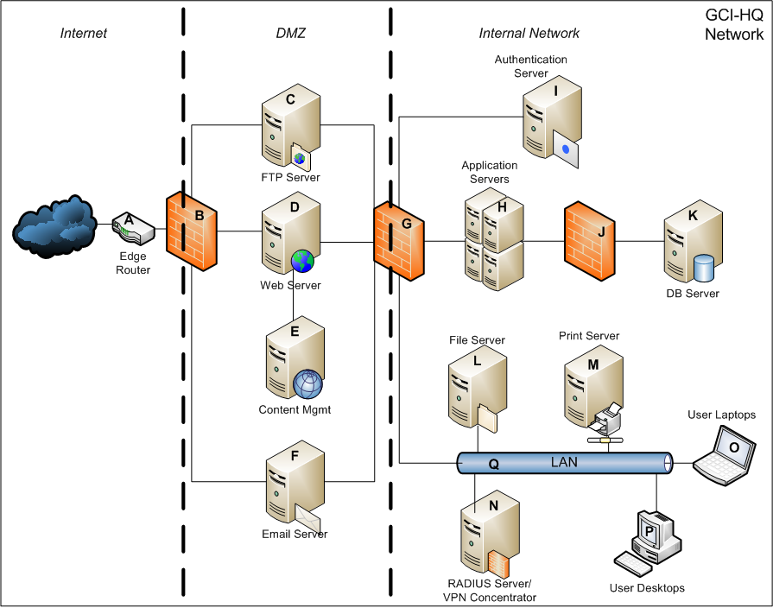
Endpoint and Network Security
Session 9
Security+
Secure Systems Design
Securing Web Servers
Security Guidelines for Web Servers.
Microsoft security guidelines for IIS (Internet Information Services)
https://technet.Microsoft.com/en-us/library/cc731278(v=ws.10).aspx
Apache web server security guidelines:
https://httpd.apache.org/docs/2.4/misc/security_tips.html
Apache web servers are the leaders for web servers in the market. Apache web servers run on the Linux operating system.

Slide 5

Endpoint and Network Security
Session 9
Security+
Secure Systems Design
Designing a Secure System that is compliant with laws and regulations requires the review of these laws and regulations before the system is built.
Regulations
Standards
Best Practices

Slide 6
Endpoint and Network Security
Session 9
Security+
Knowledge Check - 2
What is the security standard that is applicable to the United States, highly used by the US Government for security principles and policies?
A: ISO 27001
B: NIST 800-12
C: NIST 800-14
D: TEC 62443 4

Slide 7
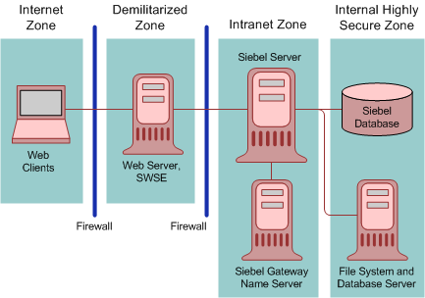
Endpoint and Network Security
Session 9
Security+
Secure Network Architectures
Zones
Network resources (servers) segmented into zones based on functional, performance or security requirements.
Secure Zone – Most sensitive
General Work Zone – Standard workstations and servers
Low Security Zone – No highly sensitive information

Slide 8
Endpoint and Network Security
Session 9
Security+
Secure Network Architectures
Zones
Network resources (servers) segmented into zones based on functional, performance or security requirements.
Secure Zone – Most sensitive
General Work Zone – Standard workstations and servers
Low Security Zone – No highly sensitive information

Slide 9
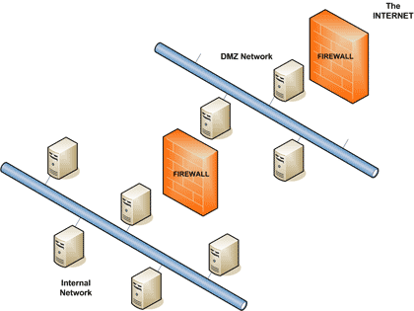
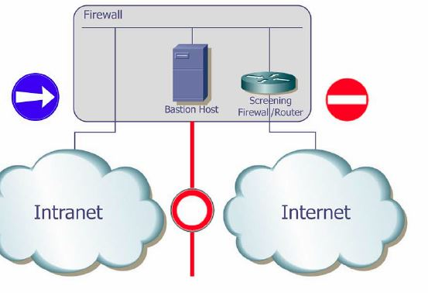
Endpoint and Network Security
Session 9
Security+
Secure Network Architectures
DMZ
Demilitarized Zone
A network infrastructure zone where web servers are placed that are exposed to public access but separated from internal networks. Firewalls are used to create DMZs.
Bastion Host
A host that exists outside the DMZ and is open to the public. Routers and firewalls, because of where they must exist often constitute a bastion host.

Slide 10
Endpoint and Network Security
Session 9
Security+
Secure Network Architectures
Intranets and Extranets
Extranet – Network infrastructure to allow a limited number of other/outside entities access to the internal intranet.
This presents security risks, because these outside entities will connect to your intranet, but may not have the same level of cyber security.
This is where network segmentation can be used as a security control.
Intranet – Network infrastructure of workstations and servers that is only accessible internally within the organization.
Intranets / private networks use the network address of Class A, Class B, or Class C private IP address ranges:
Class A Private Addresses: 10.0.0.0 – 10.255.255.255
Class B Private Addresses: 172.16.0.0 – 172.31.255.255
Class C Private Addresses: 192.168.0.0 – 192.168.255.255

Slide 11
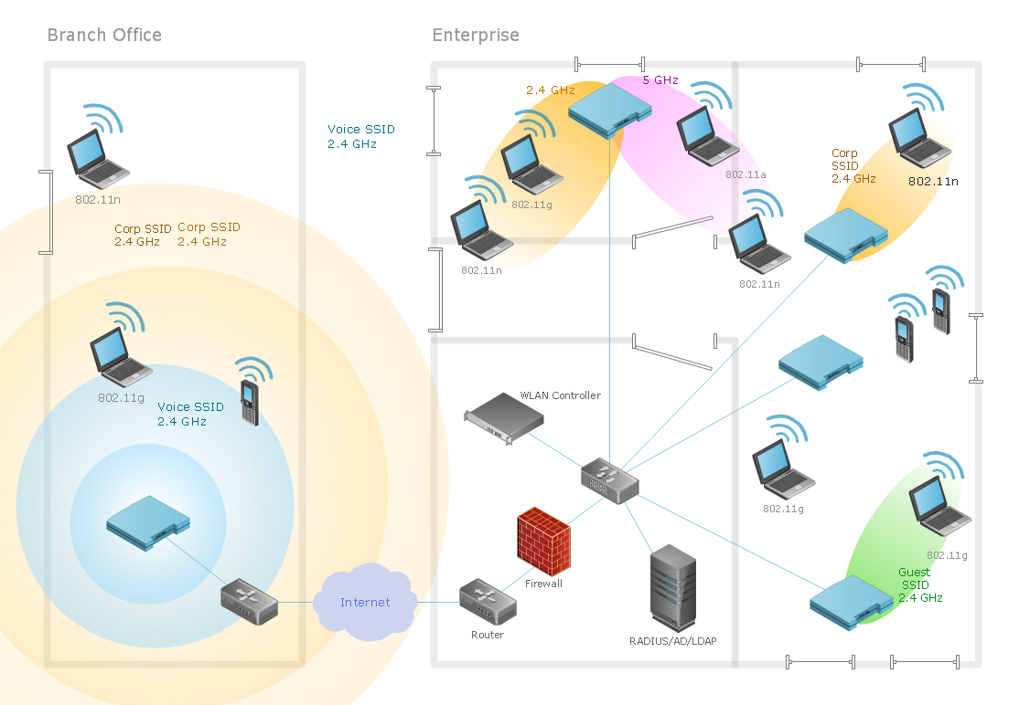
Endpoint and Network Security
Session 9
Security+
Secure Network Architectures
Wireless
Workstations or servers that access the network via a wireless connection.
Less secure than wired networks.
Security available is WEP, WPA, and WPA2
Covered in detail in separate chapter/session.

Slide 12
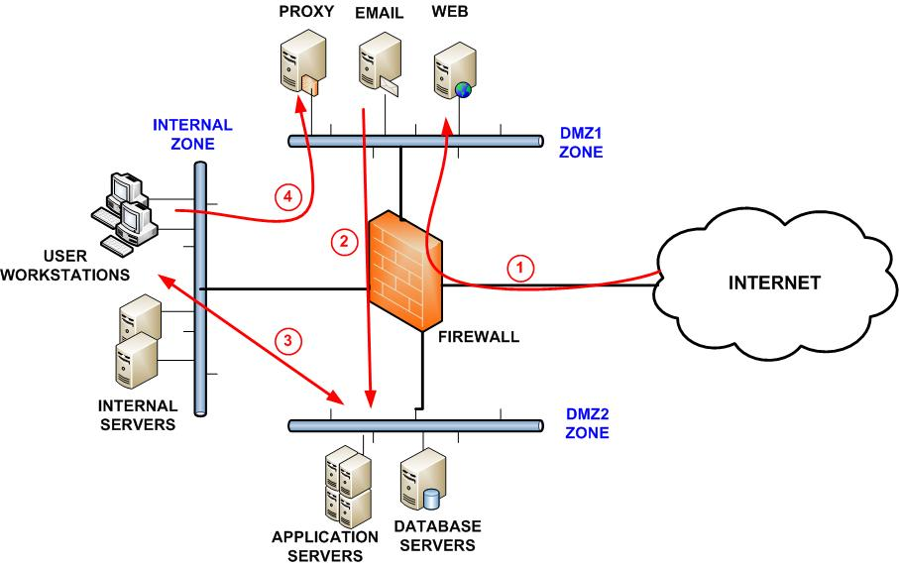
Endpoint and Network Security
Session 9
Security+
Secure Network Architectures
Segmentation and Defense in Depth
Defense in Depth is a fundamental precept of security.
Security is a layered approach, with layers and layers of security applied to the network as a defense in depth.
Vendor diversity
Control diversity (technical, physical, administrative)
User training

Slide 13
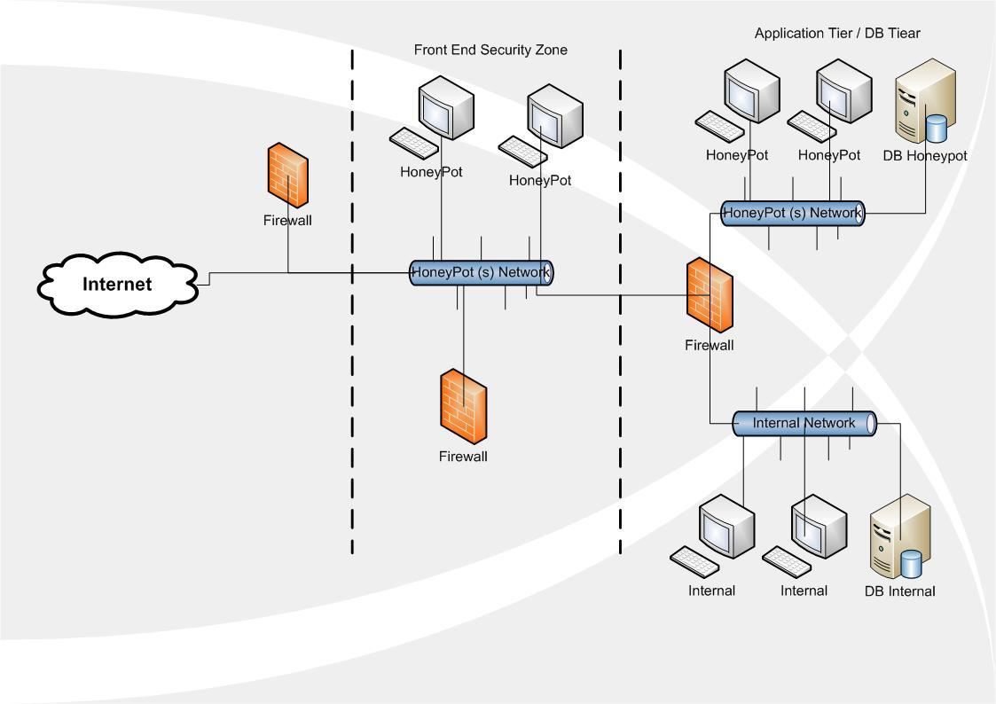
Endpoint and Network Security
Session 9
Security+
Secure Network Architectures
Honeypots and Honeynets
Individual servers (honeypots) or complete networks (honeynets) that appear to have vulnerabilities as attractive targets for attackers, but in reality, is a trap for attackers.

Slide 14
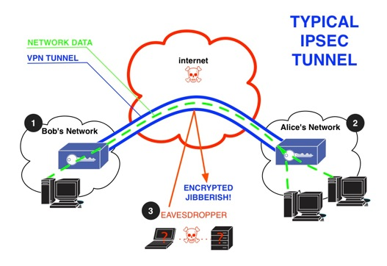
Endpoint and Network Security
Session 9
Security+
Secure Network Architectures
Tunneling / VPN
A secure connection between private networks across a public network like the Internet.
Traffic is passed using a tunneling protocol such as Layer 2 Tunneling protocol, IPSec or Point-To-Point Tunneling Protocol (PPTP)
IPSec is the most common VPN protocol and the most secure, uses encryption for all traffic.

Slide 15
Endpoint and Network Security
Session 9
Security+
Secure Network Architectures
Firewalls
Packet Filter Firewalls
A packet filter firewall is placed between the trusted and the untrusted network, blocks traffic to specific addresses based on the type of application.
Proxy Firewalls
Used to process requests from an outside network. The proxy firewall examines the requests and makes rule-based decisions about forwarding or refusing the request.
Stateful Packet Inspection Firewalls
A network firewall that tracks the operating state and characteristics of network connection. It distinguishes legitimate packets for different types of connections.
(Example: the F5 BigIP Firewall)

Slide 16
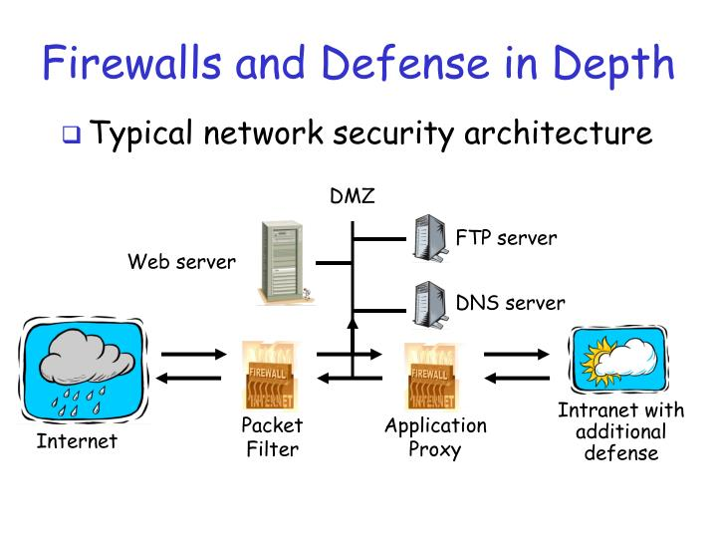
Endpoint and Network Security
Session 9
Security+
Secure Network Architectures

Slide 17
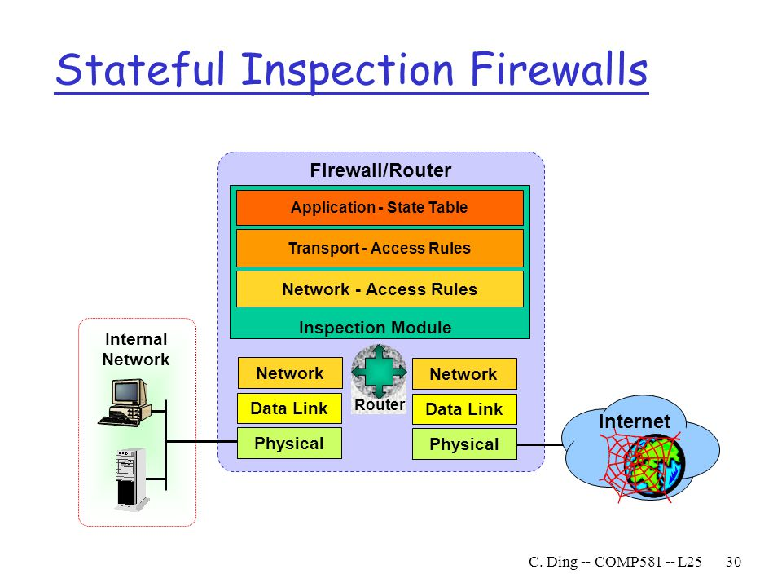
Endpoint and Network Security
Session 9
Security+
Secure Network Architectures

Slide 18
Endpoint and Network Security
Session 9
Security+
Knowledge Check - 3
What is the system that is designed to be vulnerable to hacker attacks to track hacker activity?
A: Honeypot
B: Honeybucket
C: Decoy
D: Spoofing System

Slide 19
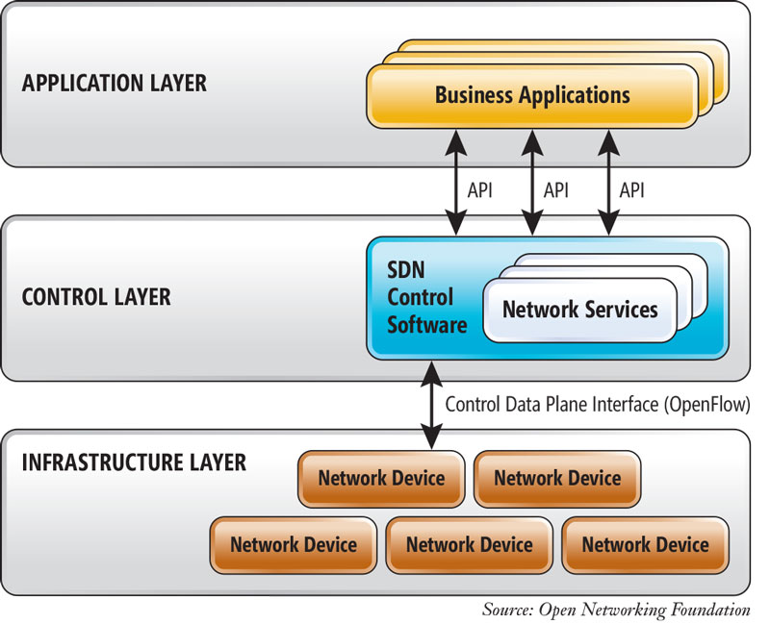
Endpoint and Network Security
Session 9
Security+
Secure Network Architectures
Software Defined Networking (SDN)
Allows the network to be decoupled from hardware and managed by a software application called a controller.
Provides programmable and active networking by allowing network managers the flexibility to configure, manage, and optimize network resources by centralizing network state in the control layer.
Biggest drivers for SDN is the growth in cloud computing, big data, and mobile computing.
Approaches to SDN –
Open Networking Foundation (OpenFlow)
Cisco proprietary (API)
Overlays

Slide 20
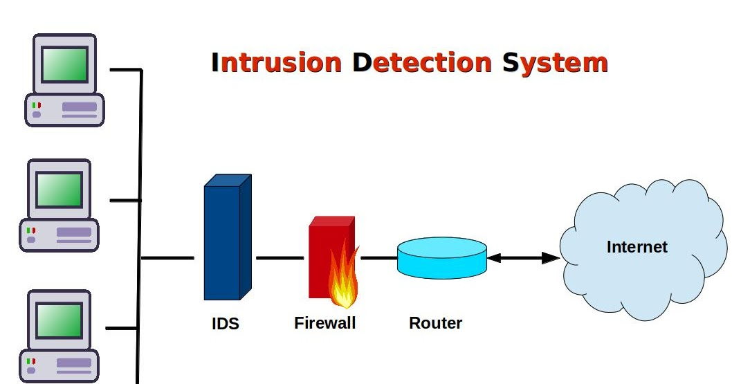
Endpoint and Network Security
Session 9
Security+
Secure Network Architectures
Intrusion Detection Systems (IDS)
A device or software application that monitors network or system activities for malicious activity or policy violations and logs the potential malicious activity.
NIDS is a Network Intrusion Detection System
Analyzes incoming network traffic
HIDS is a Host Based Intrusion Detection System
On a workstation or server, monitors operating system files for anomalies.

Slide 21
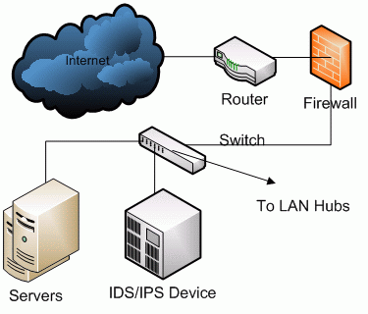
Endpoint and Network Security
Session 9
Security+
Secure Network Architectures
Intrusion Prevention Systems (IPS)
A device or software application that monitors network or system activities for malicious activity or policy violations, logs the potential malicious activity, and follow a defined set of rules for preventing the intrusion detected.
NIPS is a Network Intrusion Prevention System Monitors the entire network for suspicious activity by analyzing protocol traffic and prevents unwanted activity
HIPS is a Host Based Intrusion Prevention System An installed software package that monitors a single host for suspicious activity and acts to prevent unwanted malicious activity.

Slide 22
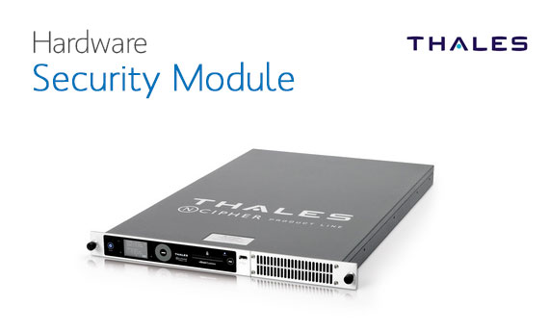
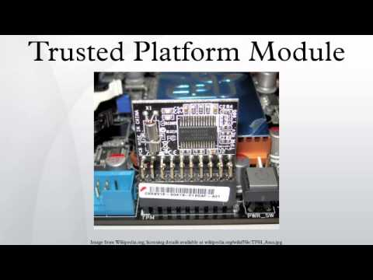
Endpoint and Network Security
Session 9
Security+
Secure Systems Design
Securing Data At Rest
Full disk encryption is provided by BitLocker for data at rest.
Hardware Security Module (HSM) – a secure crypto processor that manages cryptographic keys.
Trusted Platform Module (TPM) – a specialized chip installed on the motherboard that manages encryption at the hardware level. Hard disk data is encrypted and tied to the TPM chip and is not readable on another computer.

Slide 23
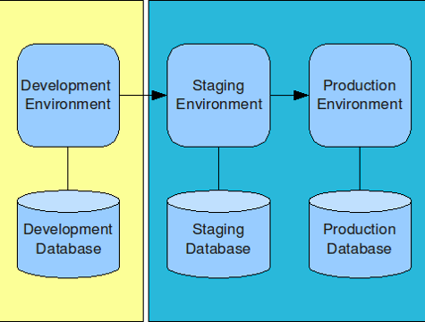
Endpoint and Network Security
Session 9
Security+
Secure Systems Design
Securing Lifecycle Deployment Environment
Separate environments for the testing and deployment of new applications, patches, new operating systems, or new devices ensures that software application vulnerabilities are not introduced into the Production Environment.
Separate isolated environments and databases allows for proper testing and documentation of all new environment changes and is a critical security feature.

Slide 24
Endpoint and Network Security
Session 9
Security+
Secure Systems Design
Developing a Host Security Baseline and maintaining security.
Secure Boot
Measured Launch
IMA – Integrity Measurement Architecture
BIOS/UEFI – Unified Extensible Firmware Interface (Since Windows 8)
Application Whitelists/Blacklists
Security Group Policies
Standard Operating Environment
Patching Known Vulnerabilities
Applying Command Shell Restrictions
Using Warning Banners
Using Restricted Interfaces
Configuring Dedicated Interfaces
Using Out-of-Band NICs
Management Interface
Data Interface

Slide 25
Endpoint and Network Security
Session 9
Security+
Thank You!!
Send questions and slide deck requests to:
Jim Reeves
Security+, CASP+,CySA+, CISSP, ITILv3, CTT+
MCSE, MCSD, MCT
jireeves@Deloitte.com

